Slide 1
arduiNO HORN
The new way to hit the roads!

Slide 2
Traditional Horn problems
Noise Pollution.
May not notify the intended vehicle.
A honk may vex the people around us.
Entertainment may increase the ignorance.
Co-passengers get annoyed.

Slide 3
arduiNO HORN solves them all!

Slide 4
How?
This module sends a message/signal/alert to the intended vehicle seamlessly, without disturbing others.
It receives the signal and convey it to the corresponding driver.

Slide 5
technology
Using an IR sensor, it sends the message in the form of IR signals whenever the driver intends, to the intended vehicle.
This could be altered by the joystick mounted on the steering, so as to define the target vehicle.
This signals are further received and decoded to alert the driver of the targeted vehicle.
This message is displayed on the dashboard, and also has the flexibility of voice assist.

Slide 6
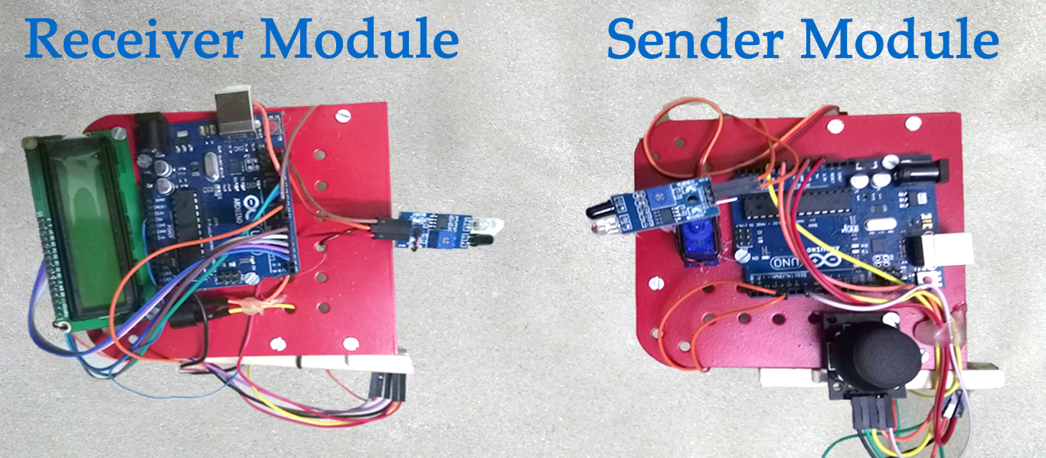
Prototype

Slide 7
deployment
This could be made available to all the masses by:
An add-on module for the existing vehicles.
Collaborating with the vehicle manufacturers.

Slide 8

Market
There are more than 30 million four wheeler vehicles in India and around 1.3 Billion all over the world.
In India, 3 million cars are sold as per the records of 2016-17.
This figure is stepping up year to year.
And the figures are way too high in the broader view.

Slide 9
scope
With a magic touch of ours the noise on roads can be greatly reduced.
Can also be interfaced with a smartphone to monitor the car remotely.
With little improvements to our current prototype, the aiming and alerting can be automated using AI.

Slide 10




team
Akhil Reddy Narala
Arshaque Mohammed
Harsha Vardan Pendyala
Vaisrav Madapathi
Phn No:
+91 8125 105 598
Email: reddy.akhil65@gmail.com
Phn No:
+91 7416 580 623
Email: mohd.arshaque@gmail.com
Phn No:
+91 8801 230 870
Email: harshasunny98@gmail.com
Phn No:
+91 8886 003 723
Email: vaisrav@gmail.com

Slide 11
Lets Hit The Roads With arduiNO HORN
Future is about to come..

